Slide 1

Case Study 1: Data Layers

Slide 2
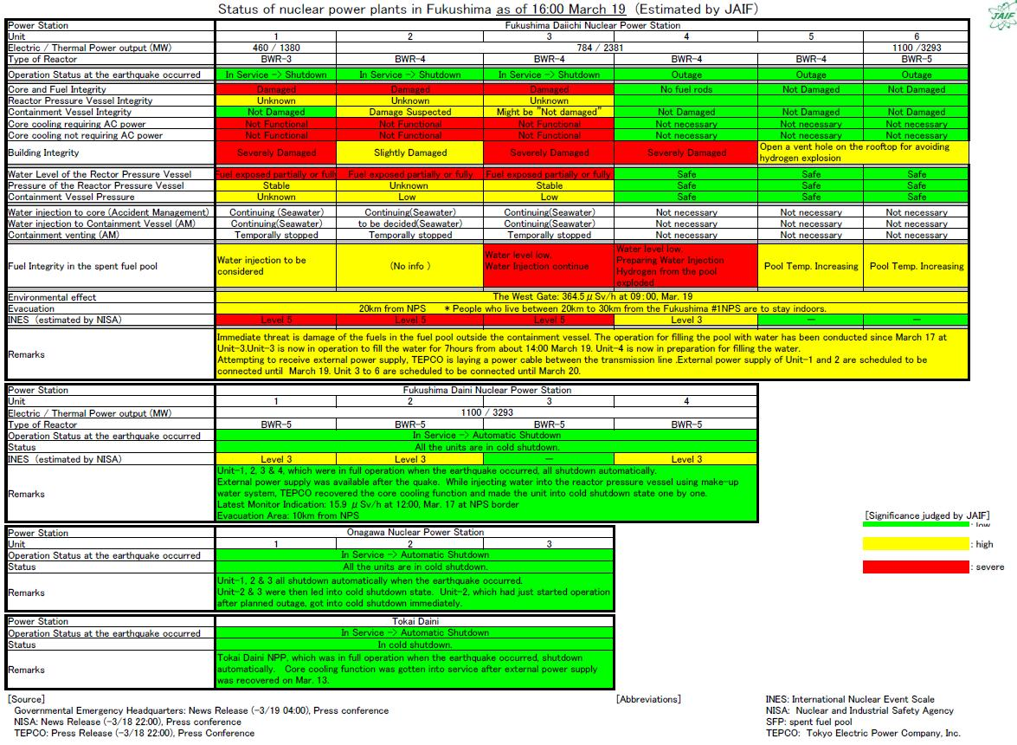
Traditional Communication
Email
Detail
Unclear

Slide 3
Layered Communications
Core IT Team
Core Business Team
All Stakeholders
+ Continue filing report for executives
Notes:
Stakeholder analysis

Slide 4
Core IT Team
Daily standups
  Review progress & blockers
Regular demos of features
Regroup to plan code releases
  As-needed basis
Notes:
JIRA tickets

Slide 5
Core Business Team
Weekly meetings
  Key stakeholder from each group
  Includes executive sponsor
Set agenda with open Q&A time
  Review IT and business tasks
  Invite developers in for demos
Notes distributed after meetings

Slide 6
All Stakeholders
Project kickoff
Monthly newsletters
Day-to-day contact
Project closing

Slide 7
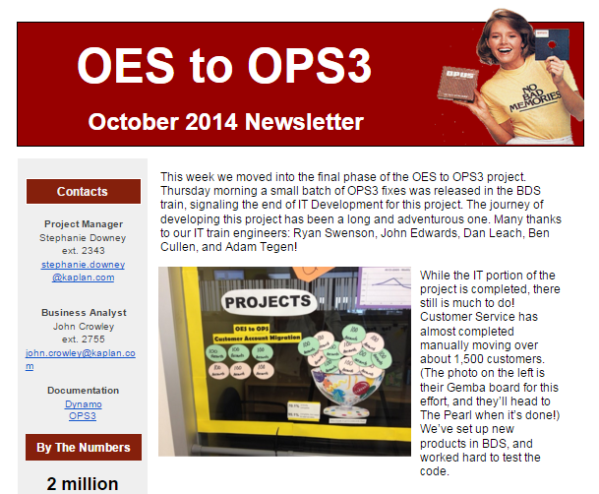

Slide 8
Case Study 1: Results
High satisfaction rates from stakeholders at retrospective
  “Project Manager and Business Analyst regularly sought feedback early in the process.”
  “This is the most engaged stakeholder group the (project manager) has worked with.”

Slide 9
Case Study 2: Data Types

Slide 10
Remember this?
Email
Detail
Unclear

Slide 11
Do What the Pros Do
Add entry points to data through Alternative Story Forms (ASFs)
  Post-Bulletin
  Mayo Clinic
Notes:
ASFs gained steam in journalism in the late 2000s
Post Bulletin C1: Q&A and localization breakout on main story, video teaser on side story
Mayo Clinic: G, Gene Testing, subheads, breakout on appointments, slideshow feel

Slide 12
Go Where the People Are
Slack for distributed teams & millennials
Get in front of people to demo features
Video conference if you can’t meet face to face
Emails still needed, but for reinforcement not primary communication

Slide 13
Get Buy-In By Listening
Release planning with sticky notes
Fishbone diagrams
Process mapping with affected groups
Always ask for more feedback

